Slide 1
Chapter 4
B2B E-Commerce

Slide 2
Learning Objectives
Describe the B2B field.
Describe the major types of B2B models.
Discuss the models and characteristics of the sell-side marketplace, including auctions.
Describe the sell-side intermediaries.
Describe the characteristics of the buy-side marketplace and e-procurement.
Explain how reverse auctions work in B2B.
Describe B2B aggregation and group purchasing models.

Slide 3
Learning Objectives
Describe other procurement methods.
Define exchanges and describe their major types.
Describe B2B portals.
Describe third-party exchanges.
Describe how B2B can benefit from social networking and Web 2.0.
Describe Internet marketing in B2B, including organizational buyer behavior.

Slide 4
Concepts, Characteristics, and Models of B2B E-Commerce
business-to-business e-commerce (B2B EC)
Transactions between businesses conducted electronically over the Internet, extranets, intranets, or private networks; also known as eB2B (electronic B2B) or just B2B

Slide 5
Concepts, Characteristics, and Models of B2B E-Commerce
THE BASIC TYPES OF B2B TRANSACTIONS AND ACTIVITIES
Sell-side
Buy-side
Exchanges
Supply chain improvements and collaborative commerce

Slide 6
Concepts, Characteristics, and Models of B2B E-Commerce
THE BASIC TYPES OF B2B E-MARKETPLACES AND SERVICES
One-to-Many and Many-to-One: Private E-Marketplaces
company-centric EC
E-commerce that focuses on a single company’s buying needs (many-to- one, or buy-side) or selling needs (one-to- many, or sell-side)

Slide 7
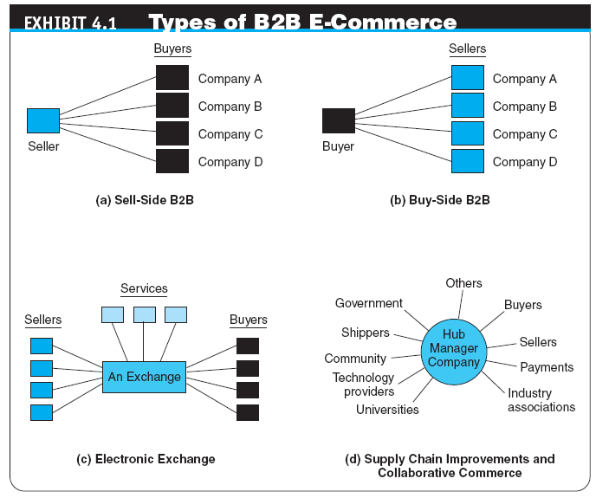

Slide 8
Concepts, Characteristics, and Models of B2B E-Commerce
Many-to-Many: Public Exchanges
exchanges (trading communities or trading exchanges)
Many-to-many e-marketplaces, usually owned and run by a third party or a consortium, in which many buyers and many sellers meet electronically to trade with each other
public e-marketplaces
Third-party exchanges open to all interested parties (sellers and buyers)
Supply Chain Improvers and Collaborative Commerce

Slide 9
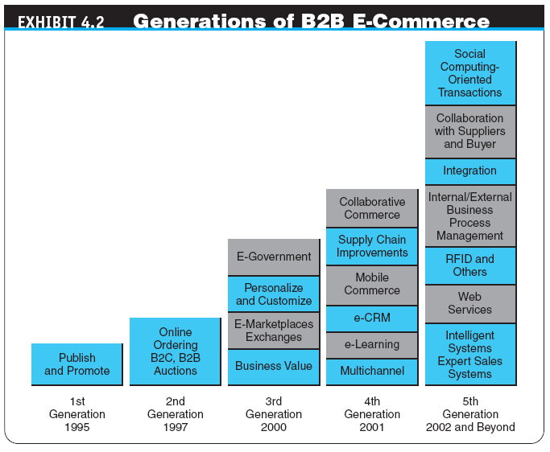

Slide 10
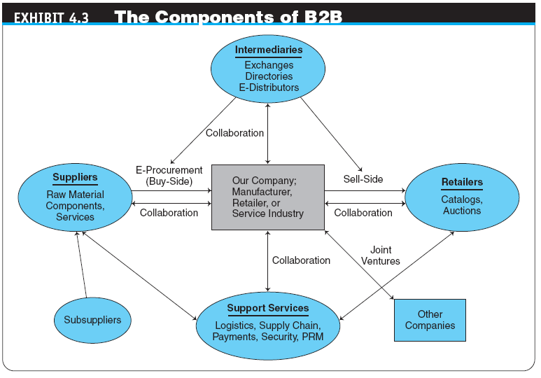

Slide 11
Concepts, Characteristics, and Models of B2B E-Commerce
B2B CHARACTERISTICS
Parties to the Transaction: Sellers, Buyers, and Intermediaries
online intermediary
An online third party that brokers a transaction online between a buyer and a seller; may be virtual or click-and-mortar

Slide 12
Concepts, Characteristics, and Models of B2B E-Commerce
Types of B2B Transactions: How Do Firms Buy?
spot buying
The purchase of goods and services as they are needed, usually at prevailing market prices
strategic (systematic) sourcing
Purchases involving long-term contracts that usually are based on private negotiations between sellers and buyers

Slide 13
Concepts, Characteristics, and Models of B2B E-Commerce
Types of Materials Traded: What Do Firms Buy?
direct materials
Materials used in the production of a product (e.g., steel in a car or paper in a book)
indirect materials
Materials used to support production (e.g., office supplies or light bulbs)
MRO (maintenance, repair, and operation)
Indirect materials used in activities that support production

Slide 14
Concepts, Characteristics, and Models of B2B E-Commerce
The Direction of the Trades
vertical marketplaces
Markets that deal with one industry or industry segment (e.g., steel, chemicals)
horizontal marketplaces
Markets that concentrate on a service, material, or a product that is used in all types of industries (e.g., office supplies, PCs)

Slide 15
Concepts, Characteristics, and Models of B2B E-Commerce
SUPPLY CHAIN RELATIONSHIPS IN B2B
SERVICE INDUSTRIES ONLINE IN B2B
PARTNER AND SUPPLIER RELATIONSHIP MANAGEMENT
partner relationship management (PRM)
Business strategy that focuses on providing comprehensive quality service to business partners
supplier relationship management (SRM)
A comprehensive approach to managing an enterprise’s interactions with the organizations that supply the goods and services it uses.
THE BENEFITS AND LIMITATIONS OF B2B

Slide 16
One-to-Many: Sell-Side E-Marketplaces
sell-side e-marketplace
A Web-based marketplace in which one company sells to many business buyers from e-catalogs or auctions, frequently over an extranet
B2B Sellers
Customer Service

Slide 17
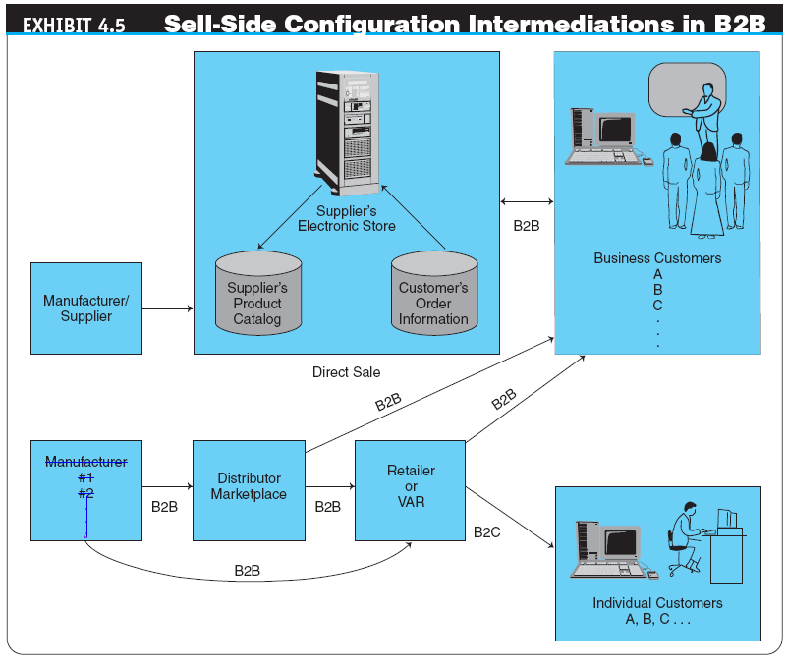

Slide 18
One-to-Many: Sell-Side E-Marketplaces
SALES FROM CATALOGS: STOREFRONT
Customization and Self-Configuration
Benefits and Limitations of Online Sales from Catalogs
COMPREHENSIVE SELL-SIDE SYSTEMS

Slide 19
Selling Via Distributors and Other Intermediaries
Manufacturers can sell directly to businesses, and they do so if the customers are large buyers.
Frequently they use intermediaries to distribute their products to a large number of smaller buyers.
The intermediaries buy products from many manufacturers and aggregate them into one catalog from which they sell to customers or to retailers.

Slide 20
Selling Via E-Auctions
USING AUCTIONS ON THE SELL SIDE
Revenue generation
Cost savings
Increased “stickiness”
Member acquisition and retention
AUCTIONING FROM THE COMPANY’S OWN SITE
USING INTERMEDIARIES IN AUCTIONS
EXAMPLES OF B2B FORWARD AUCTIONS

Slide 21
Summary
The B2B field
The major B2B models
The characteristics and models of sell-side marketplaces
Sell-side intermediaries
The characteristics of buy-side marketplaces and e-procurement

